Slide 1




Journey to Secure Agility: How Saxo Bank Embraced DevSecOps in the Era of Containers and Kubernetes
Jinhong Brejnholt
Chief Cloud Architect & PO @ Saxo Bank Cloud Native Copenhagen Organizer
jbrejnholt

Slide 2



jbrejnholt

Slide 3
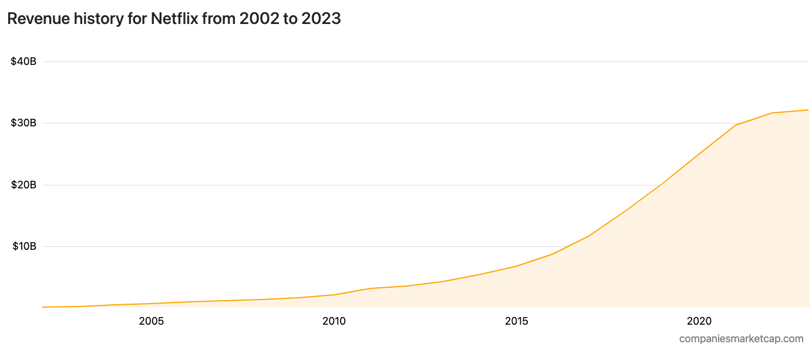
X
jbrejnholt

Slide 4

1997
jbrejnholt
Notes:
Founded in 1997, Netflix started as a DVD rental-by-mail service, allowing customers to order DVDs online and have them delivered to their homes. The company gained popularity for its hassle-free rental process and subscription model.
By the early 2000, Netflix was a dominant player in the DVD rental market. However, the rise of digital media and streaming posed a significant threat. Recognizing the shift in consumer behaviour, Netflix's leadership understood the need for transformation.

Slide 5
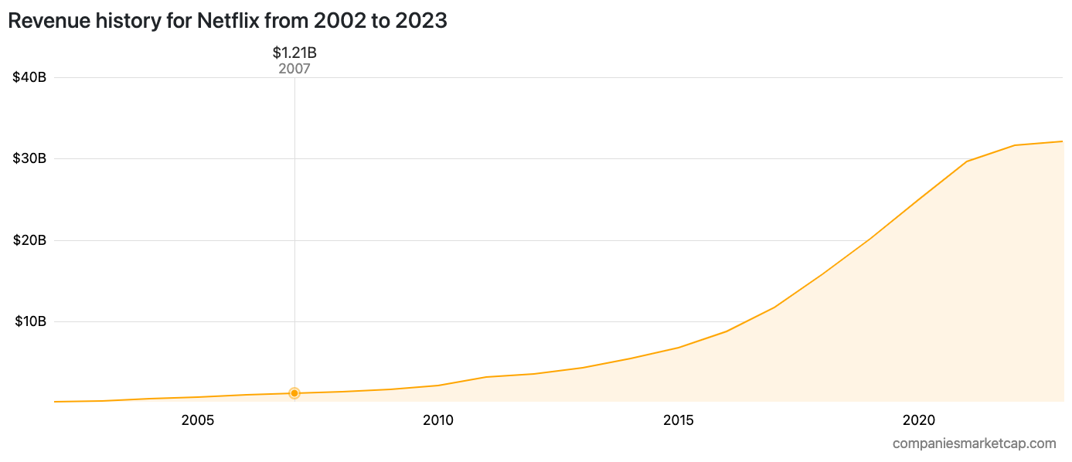

jbrejnholt
Notes:
In 2007, Netflix launched its streaming service, allowing subscribers to instantly watch a selection of movies and TV shows on their devices. This move was revolutionary, as it tapped into the growing demand for on-demand, internet-based content.
Netflix's transformation was highly successful. It went from being a DVD rental service to a global streaming powerhouse, with (247) millions of subscribers worldwide.

Slide 6

Seize the Opportunity
jbrejnholt
Notes:
Netflix's journey from a DVD rental service to a global streaming giant is a remarkable example of how a company can adapt to disruptive technologies and changing consumer preferences.
It illustrates the importance of innovation, data-driven decision-making, and a customer-centric approach in staying relevant and profitable in a rapidly evolving industry.

Slide 7
1 million clients
200+ banks and brokers
17 billion USD daily trade
jbrejnholt
Notes:
Saxo Bank A/S is a fully licensed and regulated Danish bank with an online trading platform that empowers you to invest across global financial markets.
It was founded as a brokerage firm in 1992, under different name, the name was changed to Saxo when the company obtained a banking license in 2001.
This doesn’t come if we have kept doing what we always do.

Slide 8


jbrejnholt
Notes:
“Saxo Bank is a very different bank, and we want our environment to reflect that. The T-Rex that hangs in the canteen reminds us that we need to remain agile and be on the leading edge of technology developments so that we can continue to help our clients and partners navigate the global markets. In other words, we cannot become dinosaurs.” --Kim Fournais, CEO and Founder, Saxo Bank

Slide 9

jbrejnholt

Slide 10

New Strategy
In 2019, we started our jounery
At 2020:
Established landing zone & security control
Created Kubernetes clusters
Conducted security audit
Rewrote applications
Went live
jbrejnholt
Notes:
Production grade
Both internal and external

Slide 11

That’s the year we talk to security teams
A LOT
jbrejnholt

Slide 12
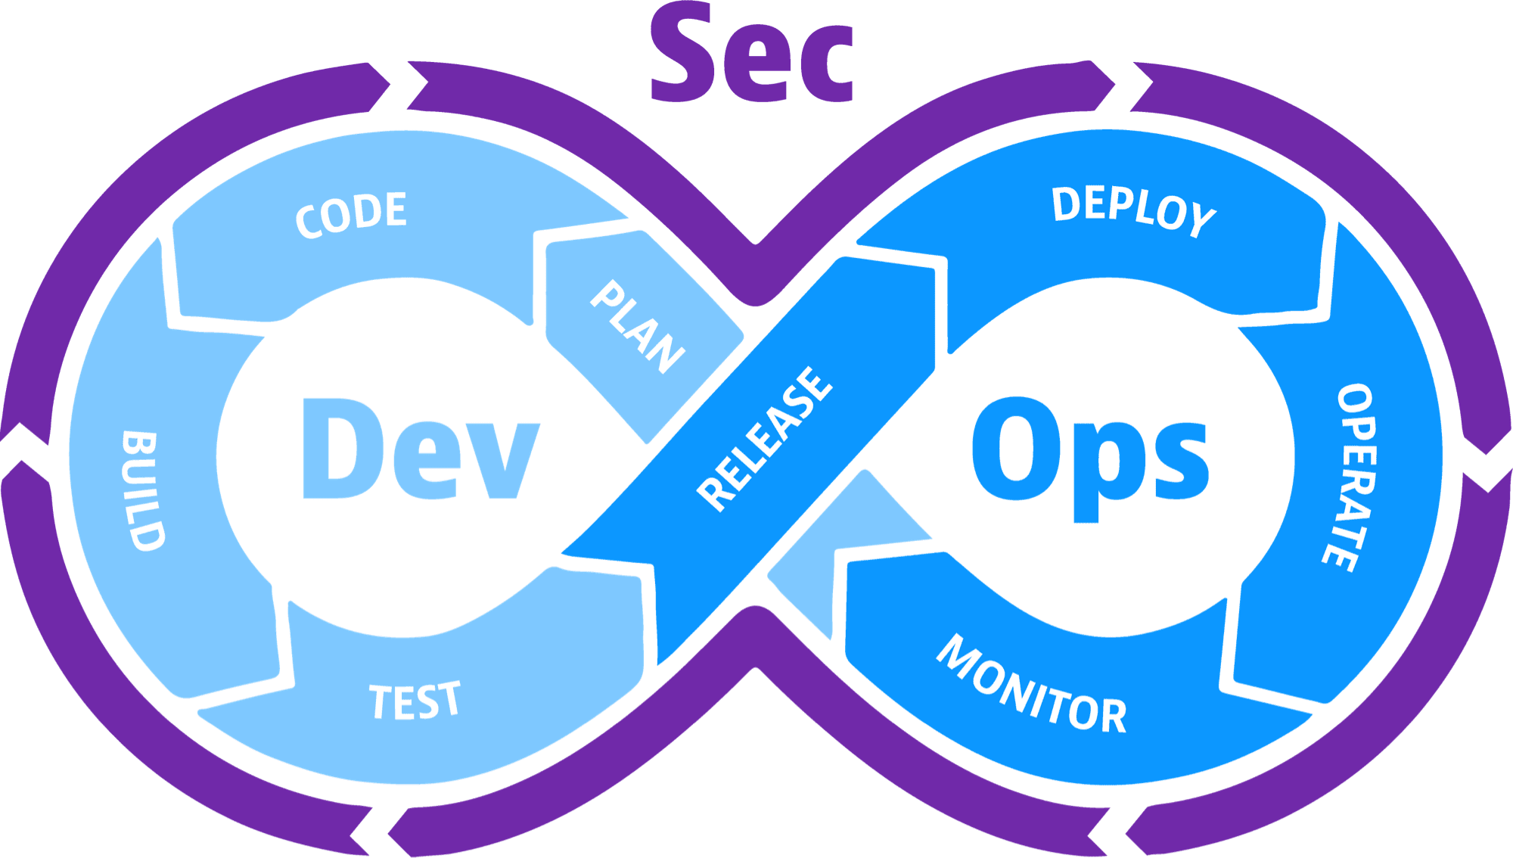
jbrejnholt
Notes:
DevSecOps stands for development, security, and operations. It's an approach to culture, automation, and platform design that integrates security as a shared responsibility throughout the entire IT lifecycle.

Slide 13

Source: giphy.com/gifs
jbrejnholt

Slide 14
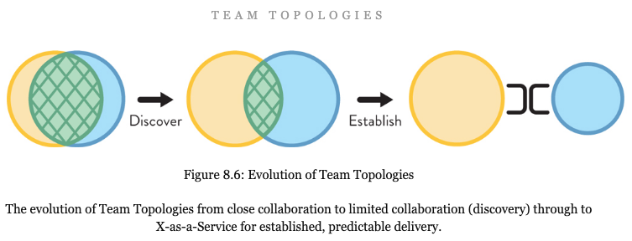
jbrejnholt
Notes:
security as part of platform offering - then we don't need to talk to security
X as a service scale
Close collabration doesn’t scale

Slide 15

The Expectations
- Code Quality - Test Coverage
1
- Artifacts Integrity - Change Process - Security and Best Practices
3
- CVE scanning
- Policies Enforcement
- Application Monitoring…
4
- Trusted Source
- CVE scanning
- License scanning
2
jbrejnholt
Notes:
What’s DevSecOps in Saxo’s context Get feedback fast Behavior
Performance
Resource consumption
...

Slide 16
The Expectations
- Code Quality - Test Coverage
1
- Artifacts Integrity - Change Process - Security and Best Practices
3
- CVE scanning
- Policies Enforcement
- Application Monitoring…
4
- Trusted Source
- CVE scanning
- License scanning
2
jbrejnholt
Notes:
What’s DevSecOps in Saxo’s context Get feedback fast Behavior
Performance
Resource consumption
...

Slide 17
The Expectations
- Code Quality - Test Coverage
1
- Artifacts Integrity - Change Process - Security and Best Practices
3
- CVE scanning
- Policies Enforcement
- Application Monitoring…
4
- Trusted Source
- CVE scanning
- License scanning
2
jbrejnholt
Notes:
What’s DevSecOps in Saxo’s context Get feedback fast Behavior
Performance
Resource consumption
...

Slide 18
The Expectations
- Code Quality - Test Coverage
1
- Artifacts Integrity - Change Process - Security and Best Practices
3
- CVE scanning
- Policies Enforcement
- Application Monitoring…
4
- Trusted Source
- CVE scanning
- License scanning
2
jbrejnholt
Notes:
Is that too much to ask?

Slide 19

The Story Doesn’t End Here…

Slide 20
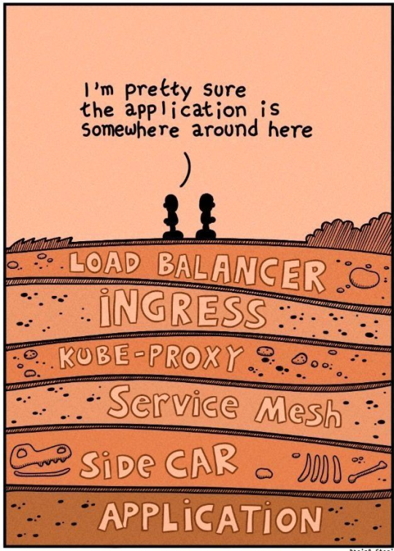
Complex tech stack
jbrejnholt

Slide 21
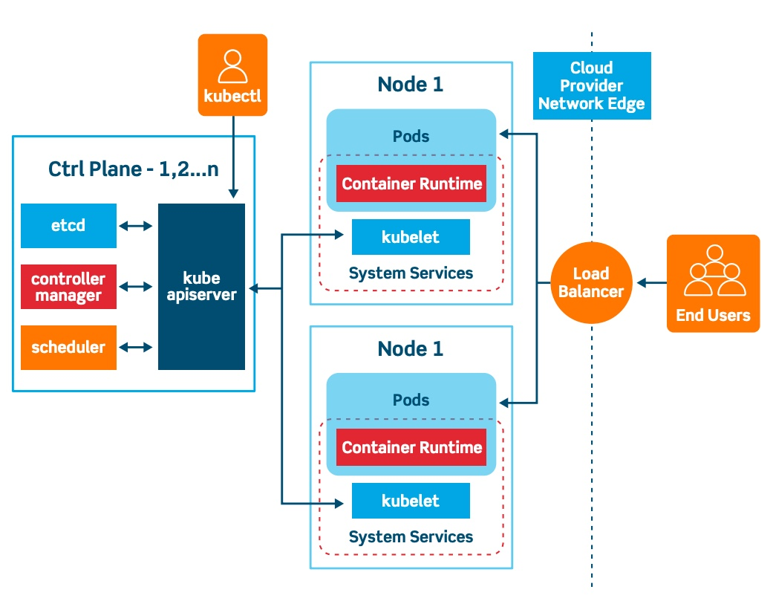
Complex tech stack
jbrejnholt

Slide 22
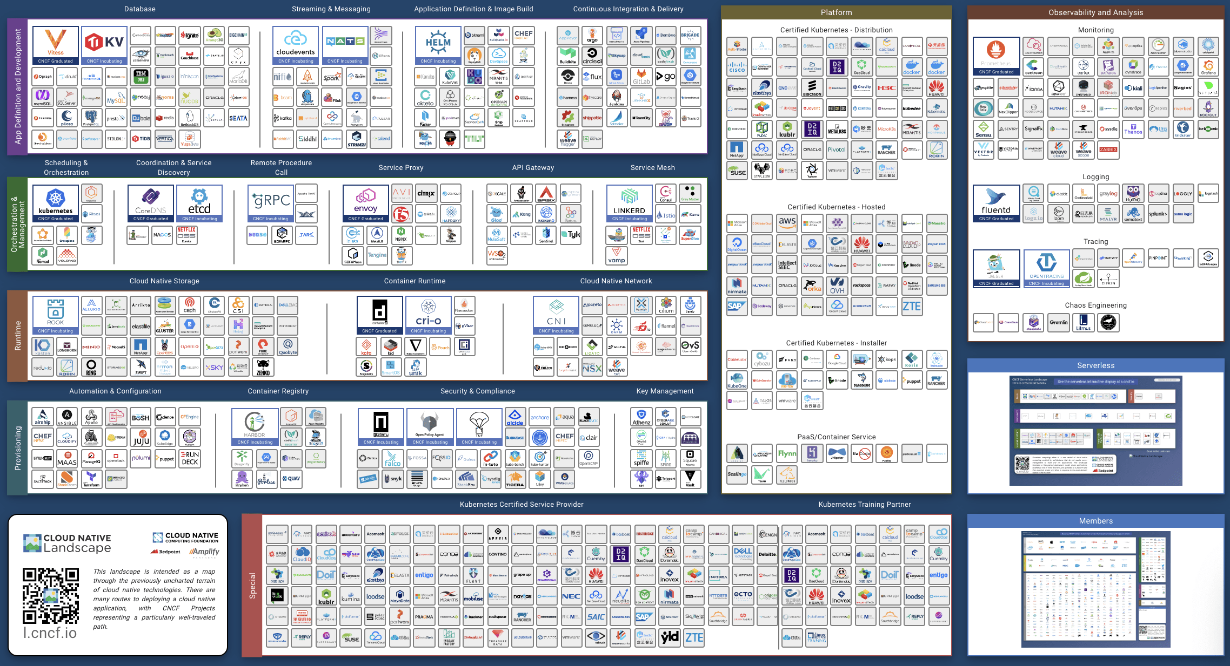
jbrejnholt
Notes:
IF that wasn’t bad enough

Slide 23

Stack Overflow’s 2020 Developer Survey
65K developers
15% - anxiety, depression, or another mental issue
83% of developers report burnout
jbrejnholt

Slide 24

jbrejnholt
Notes:
We want our developers to be happy
Happy developer -> productive developer

Slide 25



Security As Part of the Platform
jbrejnholt
Notes:
We can do more than just check

Slide 26







The Expectations
and Offers
- Code Quality - Test Coverage
1
- Artifacts Integrity - Change Process - Security and Best Practices
3
- CVE scanning
- Policies Enforcement
- Application Monitoring…
4
- Trusted Source
- CVE scanning
- License scanning
2
jbrejnholt
Notes:
not just expectations, but Offers too
hardened base image

Slide 27

Today
25 clusters and growing
10 - 50 nodes
500 deployments per day
Hybrid
jbrejnholt
Notes:
a number of DCs

Slide 28

Look Ahead
Accelerate Platform Adoption
Provide a Hybrid Container Platform
Extend GitOps Beyond Kubernetes Boundaries
jbrejnholt
Notes:
Create a culture of rapid platform adoption, empowering teams to leverage containerization and Kubernetes for enhanced agility.
Deliver a versatile container platform that seamlessly bridges on-premises and cloud environments, enabling flexibility and resource optimization.
Extend the power of GitOps to tackle challenges outside of the Kubernetes realm, such as access control, role assignment, certificate management, and DNS configuration, for comprehensive DevSecOps practices.

Slide 29




Sum up
Agile
Secure
Relevant
Platform
as a
Product
Take care of Developers
jbrejnholt
Notes:
Look out for new tech, stay agile/secure/relevent
Build security into platform offering, offer best products to consumers -> product is to satisfy needs, customer should have a choice
There will always be complexity – hide <- abstract <- educate
Not just frrom platform, but in general, offer a great environment for developers
Take care of developers -> business

Slide 30

Thank You
jbrejnholt
Notes:
Stockholm

Slide 31

Thank You
jbrejnholt
Notes:
CPH

